Slide 1
A Range of Trusts

Slide 2
If you are interested in finding out more about this service, please complete and submit our General Enquiry form found at the following link - https://www.henderson-fiduciary.com/contact. Alternatively give us a call at (852) 2157 3705 to arrange a confidential meeting to discuss your requirements
The following information does not constitute legal advice and you should not regard this as a substitute for particular advice for individual circumstances

Slide 3
Trust Overview
This is a complex subject in which we have decades of experience in succession planning and Trust structuring to achieve the most effective Trust arrangement for each case.
There are different types of Trusts for different purposes depending on the settlor’s needs and goals. However, the essential characteristic of all Trusts is the separation of legal and beneficial ownership. The settlor transfers the asset to be held in trust to the Trustee (who then becomes the legal owner) who owes fiduciary duties towards the beneficiaries (who are the beneficial owners) and must act in the beneficiaries’ best interests.
Generally speaking, Trusts can be separated into three categories: (1) inter vivos or testamentary; (2) revocable or irrevocable; (3) fixed or discretionary. The categories may overlap. For example, one of the most common estate planning tools is an inter vivos irrevocable discretionary Trust. Each type of Trust is explained in more detail in the following slides.

Slide 4
Inter-Vivos Trust (also known as Living Trust)
This type of Trust is created during the settlor’s lifetime. Ownership of the assets is passed to the Trustee when such assets are injected into the Trust by the settlor. The Trust can begin to operate (i.e. benefit the beneficiaries) as soon as the assets have been injected into the Trust.
It is common for this type of Trust to benefit the settlor during the settlor’s lifetime and continue to benefit the settlor’s surviving family members and/or charities after the settlor’s death. An inter vivos Trust can be revocable or irrevocable. The Trustee can be given lots of discretion or the settlor can retain more control depending on how the Trust deed is drafted.

Slide 5
Testamentary Trust (also known as Will Trust)
A testamentary Trust is formed under the terms of the will. The will should include Trust provisions (like those in a Trust deed) to govern the Trustee’s powers and obligations. The settlor is the testator (will-maker) and the Trustee is usually the executor. The Trust fund is the residuary estate (i.e. the estate after any debts/expenses had been paid and any specific legacy under the will had been distributed). Ownership of the assets remains with the settlor testator until his death and the probate process must be completed before the Trustee can benefit beneficiaries. In short, the Trust is only created upon the settlor’s passing. (Not the most tax efficient way to structure, as exemptions for potentially exempt, lifetime transfers, (PETs)) are lost. Also, as it is formed by a Will, so it can be challenged before the setup is completed.)

Slide 6
Revocable Trust
A revocable Trust can be changed or revoked by the settlor at any time and the Trust assets would revert back to the settlor. Although this gives the settlor more flexibility and room to change his mind, it is less useful in terms of asset protection, (for example, if the settlor is being sued, the Trust assets may still be deemed as the Settlor’s assets and subject to third-party claims. It also does not take advantage of PETs).

Slide 7
Bare Trust
Bare Trust, sometimes also known in Asia as a Family Trust. Allows the head of the family, (the Settlor), to retain control of the assets yet have them held by an independent Trustee.
It allows the beneficiaries to be amended during the Settlor’s lifetime and obfuscates the ability of the potential beneficiaries to challenge the wishes of the Settlor, such as the fiasco with the 8 year legal battle over the will of one of the richest women in the world. The estates being frozen by the courts during this time.

Slide 8
Irrevocable Trust
An irrevocable Trust cannot be revoked after the Trust deed has been signed and the assets have been injected into the Trust. The beneficiaries’ interests under an irrevocable Trust are more secured. Since the settlor gives up control, asset protection is more effective.

Slide 9
Standard Reserve Power Trust
This type of Trust is an Irrevocable Trust for the assets settled into the Trust, yet it allows the Settlor to amend the named beneficiaries, exclude existing named beneficiaries and to add new named beneficiaries, or classes of beneficiaries, importantly without the right of the existing beneficiaries to object to their removal.

Slide 10
Fixed Trust
Each beneficiary’s entitlement to the Trust fund under the Trust is specifically set out in the Trust deed and the Trustee has no discretion regarding the distribution of the Trust fund. This type of Trust is most certain, but the Trustee is less equipped to deal with contingencies that may arise in the future.
For example, if a beneficiary is subject to divorce or third-party claims, the Trustee may not have discretion to suspend distribution until after the situation is resolved. Or if a beneficiary suddenly requires funds in the event of a medical emergency, the Trustee may not have the discretion to make a bigger distribution for that beneficiary.

Slide 11
Discretionary Trust
Each beneficiary’s entitlement to the Trust fund under the Trust is not fixed and the Trustee is given many powers and flexibility to deal with changes in circumstances such as death or divorce of a beneficiary, changes in tax regimes and legislations.
Distributions can be in different amounts, in different stages or contingent upon certain conditions. Because a discretionary Trust confers so much flexibility, it is typically accompanied by a more detailed letter of wishes which sets out the settlor’s instructions as to how to exercise discretion, distribution timing, guidelines and conditions, circumstances for suspension of distribution and etcetera. Although a letter of wishes is non-binding, most Trustees, especially professional Trustees, typically follow the guidance contained therein.

Slide 12
Other Trusts
In addition to the above categories, there are also Trusts specific for tax planning. Such as a foreign grantor Trust to avoid US federal gift and estate tax for non-US settlors who wish to benefit US beneficiaries. However, no Trust can eliminate the need to make a will (except for a testamentary Trust which is created by the will itself) because if there are any assets not transferred into the Trust right before the settlor’s death, these will be disposed of in accordance with intestacy laws, which may not correspond with the settlor’s wishes.
Moreover, depending on the type of asset, and location of the asset and the beneficiaries, transfers to a Trust may carry stamp duty or tax whereas estate duty has been abolished in Hong Kong (i.e. there is no tax against a bequest under will). For many clients, the best solution is a standby Trust used in conjunction with a pour-over will whereby the settlor retains control over his assets in his lifetime and upon his death, the majority of his estate will be transferred to the stand-by Trust (created during his lifetime) via his will to be managed by the Trustees in the best interests of the beneficiaries.

Slide 13
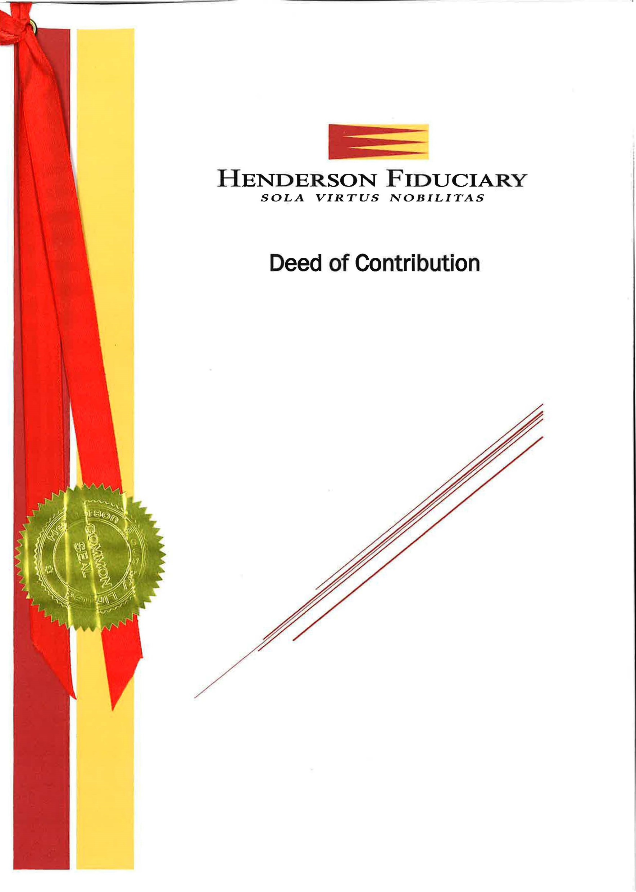
Henderson Fiduciary Sealed Deed Example

Slide 14
Contacts

