Slide 1
Occupational Retirement Schemes

Slide 2
Contents – 內容
1. Hong Kong Trust - 香港信托优势
2. Hong Kong ORSO - 香港退休金信托
3. ORSO Tax Advantage -退休金信托税务优势
4. Q & A – 问答环节

Slide 3
Hong Kong – An International Trust Centre
Well established legal system based on English common law
完善的基于英国普通法的法律制度
Given a long history of over 100 years from 1903, Hong Kong Trust Law is comprehensive and sophisticated.
自1903年以来已有一百多年的悠久历史，《香港信托法》是全面而完善的。
Favorable tax regime
有利的税收制度
Perpetuity Period of Trust
永续期
reputable international financial Centre
信誉卓著的国际金融中心

Slide 4
Registered Pension Trust – ORS
注册退休金信托
What is ORSO - 退休金信托计划
ORSO stands for "Occupational Retirement Schemes Ordinance".
ORSO 全名为职业退休计划条例
ORSO was enacted in December 1992 and came into operation in October 1993.
ORSO 于1992年十二月立法，1993年十月开始运作
The objective of ORSO is to establish a registration system for voluntarily established occupational retirement schemes, to ensure that such schemes are properly regulated, and to provide greater certainty that retirement scheme benefits promised to employees will be paid when they fall due.
职业退休计划的目标是建立一个自愿设立的职业退休计划注册制度，确保这些计划得到适当的管理，并为对雇员承诺的退休计划福利在到期时得以支付提供更大的确定性。
Registered Pension trust ORSO is a Non-Vested Pension Plan
注册退休金计划是“非归属”的退休金计划

Slide 5
Parties to the Pension Trust - ORSO
退休金信托结构
受托人
Trustee
Pension
Trust
退休金信托
雇主
Sponsor
计划成员
Member

Slide 6
THE SUMMARY OF BENEFITS OF ORSO
退休金信托好处
Asset Protection 资产保护
Divorce-proof 避免离婚后的财产分割
Privacy 隐私保护
Tax Efficiency 税务效率
Extremely Valuable Benefits – No Probate 无需遗嘱安排
Flexible Contribution 灵活供款
Investment choices 投资选择

Slide 7
WHY NON-VESTED
为何选择“非归属”
WHEN THE DIVORCE STRIKES
当提出离婚时
WHEN THE CREDITORS HUNT
当债权人追讨时
WHEN THE TAX MAN ASKS
当税务局询问时
WHEN YOU INVEST VIA THE PENSION FUND
当你透过退休基金购买资产时
PAYMENTS OUT AT RETIREMENT – ORS vs MPF

Slide 8
ORS WITHDRAWAL COMPARED TO MPF ORS提款同MPF的比較
 | ORS | MPF
Retirement Age 55 (MPF 65) | Y | N
100% Accumulated Funds Distributed at Retirement | You have the Choice | Y
Choice Whether Funds Distributed at Retirement | Y | N
Succession Planning | Y | N
Potential Death Duties Exemption | Y* | N
Tax Free Income in Retirement (38 Countries including Mainland of China) | Y | N
*applicable to some countries

Slide 9
THE SUMMARY OF BENEFITS OF THE PLAN
计划优势
Asset Protection 资产保护
Divorce-proof 避免离婚后的财产分割
Privacy 隐密性
Tax Efficiency 税务效率
Extremely Valuable Benefits – No Probate 无需遗嘱安排
Flexible Contribution 灵活供款
Investment choices 投资选择

Slide 10
ORSO scheme excluded from matrimonial property
退休金信托不包括在婚姻财产之內
HCMP 1780/2013
IN THE HIGH COURT OF THE HONG KONG SPECIAL ADMINISTRATIVE REGION COURT OF FIRST INSTANCE MISCELLANEOUS PROCEEDINGS NO 1780 OF 2013
IN THE MATTER of Sections 7and 9 of the Maintenance Order (Reciprocal Enforcement)Ordinance, Cap 188 and Part I of the Schedule of the Maintenance Orders (Reciprocal Enforcement) (Designation of Reciprocating Countries) Order, Cap 188B
and
IN THE MATTER of the registration and enforcement of a maintenance order made by the Superior Court of Justice Family
Court Branch of Ontario, Canada dated 15 January 2009
and
IN THE MATTER of a worldwide Mareva Injunction application
BETWEEN SUZANNE RUTH HENDERSON Plaintiff and SCOTT HENDERSON Defendant
Before: Hon Au-Yeung J in Chambers
Date of Hearing: 22 October 2014
Date of Decision: 23 October 2014
REASONS FOR DECISION
22. Thirdly, I have already stated in paragraph 22 and 23 of the Decision as to why, notwithstanding the disclosure of the provident fund as an “asset” or “property” of the defendant, the provident fund was not an available asset until it is vested
to the defendant. That was based on Mark Hoyle, Freezing & Search Order (4th ed), at §4.28 applicable to injunctions.

Slide 11
THE SUMMARY OF BENEFITS OF THE PLAN
计划优势
Asset Protection 资产保护
Divorce-proof 避免离婚后的财产分割
Privacy 隐密性
Tax Efficiency 税务效率
Extremely Valuable Benefits – No Probate 无需遗嘱安排
Flexible Contribution 灵活供款
Investment choices 投资选择

Slide 12
LEGAL RESPONSE FOR A TRUSTEE ON THE ANNUAL AUDIT
受托人每年的法定申报内容
FOR OVERSEAS MEMBERS, WE HAVE TO NOTIFY THE HK IRD THAT WE HAVE THEM AS A MEMBER, BUT THE VALUE OF THEIR ACCOUNT IS ZERO!
THE VALUE OF THE ALL THE MEMBERS ACCOUNT COMBINED IS ZERO!
所有成员信托账户的现金价值 – “0”
THE PENSION HOLDS X DOLLARS IN VALUE
信托计划代持的总金额 – “X”
WE HAVE X NUMBER OF MEMBERS WHO ARE HK PERMANENT RESIDENTS
信托有多少成员是香港永久居民
WE HAVE TOTAL NUMBER OF MEMBERS
信托共有多少成员
THE MEMBERS HAVE CONTRIBUTED X DOLLARS
THE COMPANY HAS CONTRIBUTED X DOLLARS
HOW MUCH WE PAID OUT
成员及企业的供款总金额、受托人支付的退休金总额
HOW MUCH WE RECEIVED IN NEW CONTRIBUTIONS
受托人所收到新供款的总额

Slide 13
SECRECY RULES FOR ORS UNDER LAW
香港法律下职业退休计划的保密条例
Chapter 426 Occupational Retirement Schemes Ordinance
第426章 《职业退休计划条例》
77. Preservation of secrecy
Subject to sections 32, 78 and 78A and subsection (2), any person who acquires any information by virtue of his performance or assistance in the performance of functions under this Ordinance shall preserve secrecy with regard to such information and without prejudice to the foregoing shall not— (Amended 1 of 2015 s. 56)
(a) disclose such information to any other person except where such disclosure is necessary to such performance or assistance; or
(b) suffer or permit any other person to have access to such information except where such access is necessary for that other person to perform or assist in the performance of functions under this Ordinance.
Nothing in this section shall be construed as prohibiting disclosure of such information in pursuance of a court order, a rule of law or a requirement made under a rule of law.
Any person who contravenes subsection (1) commits an offence and shall be liable on summary conviction to a fine of $20,000.
77. 保密
除第32、78及78A条及第(2)款另有规定外，任何人因执行或协助执行本条例下的职能而获悉任何资料，均须对这些资料保密；而在不影响上文的情况下，该人 — (由2015年第1号第56条修订)
(a) 不得向别人披露这些资料，但因执行或协助执行上述职能而必须披露这些资料，则不在此限；或
(b) 不得任由别人或准许别人接触这些资料，除非该人因执行或协助执行本条例下的职能而必须接触这些资料，则不在此限。
本条不得解释为禁止依据法庭命令、法律规则或根据法律规则作出的规定而披露上述资料。
任何人违反第(1)款，即属犯罪，循简易程序定罪后，可处罚款$20,000。

Slide 14
WHEN AND WHAT CAN THE TRUSTEE SAY UNDER HK LAW
香港法律下受托人所作的披露
Chapter 426 Occupational Retirement Schemes Ordinance
第426章 《职业退休计划条例》
78A.Disclosure by administrator or relevant employer
Despite section 77, an administrator or the relevant employer of an occupational retirement scheme may disclose information if —
(a) the Registrar has given written consent; and
(b) any of the following applies —
(i)the person to whom the information relates has given written consent;
(ii)the information is disclosed in a manner that prevents particulars relating to the identity of the person to whom the information relates from being ascertained from the information.
The Registrar may give consent only if —
(a)the information is to be disclosed to a person located in a place outside Hong Kong;
(b)the person exercises or performs in that place functions that correspond to those of the Commissioner of Inland Revenue; and
(c)the Registrar is satisfied that the disclosure will enable or assist the person to exercise or perform the person’s official functions.
The Registrar may, in giving consent, impose conditions that it considers appropriate. (Added 1 of 2015 s. 57)
78A. 管理人或有关雇主所作的披露
尽管有第77条的规定，管理人或职业退休计划的有关雇主，可在符合以下情况下披露资料 —
(a) 处长已给予书面同意；及
(b) 有任何以下情况 —
(i) 该等资料所关乎的人，已给予书面同意；
(ii) 该等资料的披露方式，是足以不让人从该等资料中，确定该等资料所关乎的人的身分的详情。
处长只可在以下前提下给予同意 —
(a) 有关资料将会向身处香港以外地方的人披露；
(b) 该人在该地方行使或执行的职能，相当于税务局局长的职能；及
(c) 处长信纳该项披露，将会使该人得以行使或执行该人的官方职能，或将会有助该人行使或执行该等职能。
处长在给予同意时，可施加其认为适当的条件。 (由2015年第1號第57條增補)

Slide 15
Email correspondence with the HK deputy commissioner IRD and HK Assistant Secretary of Financial Services IRD
Dear Ms Henderson,
Apologies for the late reply. Further to my email on 18 October 2018, I wish to provide further information on the arrangements in relation to the reporting requirements for the non-vested portions of ORSO schemes.
A reporting financial institution must report the balance or value of reportable accounts as of the end of the calendar year or other appropriate reporting period. In general, the balance or value to be reported is the amount which the financial institution calculates for the purpose of reporting to the account holder.
As advised by the Inland Revenue Department, in respect of non-vested benefits, if, for regulatory and customer reporting purposes during the non-vested period, the ORSO administrator calculates the account balance as zero in respect of the non-vested portion (as there is no vested benefit accrued to the scheme member), the value in respect of this portion should be reported as zero as well. It should be emphasized that the beneficiary should still be reported in this case, only that the account value in respect of the non-vested portion would be zero. In subsequent years, should these amounts become vested in the member, the account balance should reflect such increase accordingly.
Please feel free to contact us if there is anything you would like to discuss. Thank you very much.
Kind regards,
Austin HSU
Assistant Secretary for Financial Services

Slide 16
Dear Ms Henderson,
抱歉晚回复。除2018年10月18日我的电子邮件外，我想提供有关ORSO计划未归属部分报告要求的安排的更多信息。报告财务机构必须报告自日历年末或其他适当报告期末的应报告帐户的余额或价值。通常，要报告的余额或价值是金融机构为报告给帐户持有人而计算的金额。 根据税务局的建议，对于非归属收益，如果出于非归属期的监管和客户报告目的，ORSO管理员将非归属部分的帐户余额计算为零（计划成员没有应得的既得利益），这部分的价值也应报告为零。应该强调的是，在这种情况下，仍应报告受益人，只有未归属部分的账户价值为零。在以后的年份中，如果这些款项归属会员，则帐户余额应相应地反映出这种增加。如果您有任何要讨论的问题，请随时与我们联系。非常感谢你。
Kind regards,
Austin HSU
Assistant Secretary for Financial Services

Slide 17
THE SUMMARY OF BENEFITS OF THE PLAN
计划优势
Asset Protection 资产保护
Divorce-proof 避免离婚后的财产分割
Privacy 隐密性
Tax Efficiency 税务效率
Extremely Valuable Benefits – No Probate 无需遗嘱安排
Flexible Contribution 灵活供款
Investment choices 投资选择

Slide 18
MAINLAND CHINA & HONG KONG DTA PASSED BY BOTH GOVERNMENTS 27TH OCTOBER 2006 - A DIRECT EXTRACT FROM THE REVENUE WEB SITE, FEBRUARY 14TH 2020
Article 17 Pensions
退休金
2. Notwithstanding the provisions of paragraph 1 of this Article, pensions and other payments (whether a payment in lump sum or by instalments) made under a pension scheme which is:
(1)
a public scheme which is part of the social security system implemented by the Government of One Side or a local authority thereof;
(2)
an arrangement in which individuals may participate to secure retirement benefits and which is recognized for tax purposes in One Side,
shall be taxable only in the Side in which the scheme is implemented. (IRO- cap 112 part 3, section 8,1,b.)
shall be taxable only in the Side in which the scheme or arrangement is
implemented.
雖有本條第一款的規定，從以下退休金計劃支付的退休金和其它類似款項(不論是分次支付或一次支付)，即：
(一) 一方政府或地方當局作為社會保障制度一部分而推行的公共計劃；
(二) 可讓個別人士參與以確保取得退休福利的安排，且該等安排是按照一方法律為稅務目的而獲認可的，
應僅在實施計劃的一方徵稅。

Slide 19
International Tax Treatment of Pension & Retirement Funds
退休基金的国际税务规划
List of some of the Hong Kong Double Taxation Avoidance Agreements where the treaty provides from income tax freedom on the HK ORS pension income to residents:
以下是与香港签订避免双重课税协定的国家列表：
Austria 奧地利 | Czech 捷克 | India 印度 | Liechtenstein 列支敦士登 | Mexico 墨西哥 | Saudi Arabia 沙特阿拉伯 | United Kingdom 英國
Belarus 白俄羅斯 | Estonia 愛沙尼亞 | Indonesia 印尼 | Luxembourg 盧森堡 | Netherlands 荷蘭 | South Africa 南非 | Vietnam 越南
Belgium 比利時 | Finland 芬蘭 | Ireland 愛爾蘭 | Macao 澳門特別行政區 | Pakistan 巴基斯坦 | South Korea 韓國
Brunei 文萊 | France 法國** | Jersey 澤西島 | Mainland of China 中國 | Qatar 卡塔爾 | Switzerland 瑞士
Cambodia 柬埔寨 | Guernsey 根西島 | Kuwait 科威特 | Malaysia 馬來西亞 | Romania 羅馬尼亞 | Thailand 泰國
Canada 加拿大 * | Hungary 匈牙利 | Latvia 拉脫維亞 | Malta 馬耳他 | Russia 俄羅斯 | United Arab Emirates 阿聯酋

Slide 20
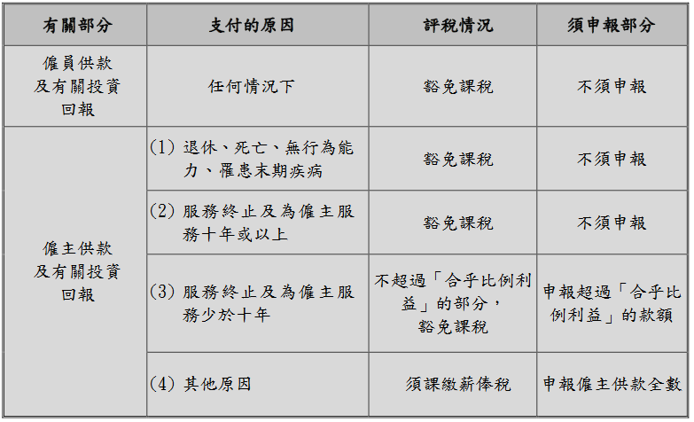

Slide 21
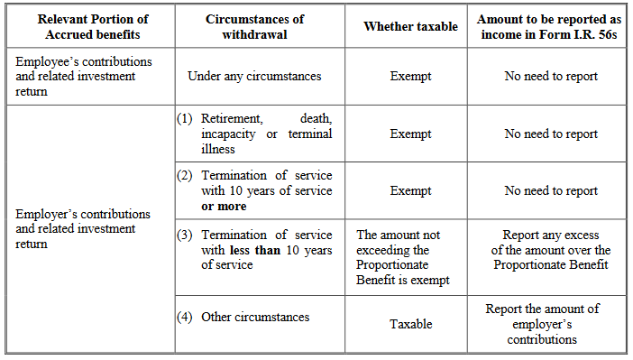
ORS Taxation Table 退休金信托税表

Slide 22
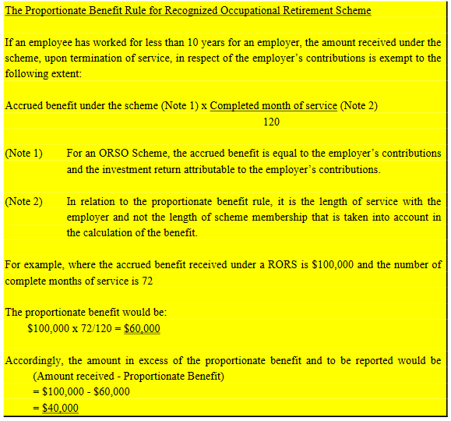
The Proportionate Benefit Rule
什么是合乎比例的利益?

Slide 23
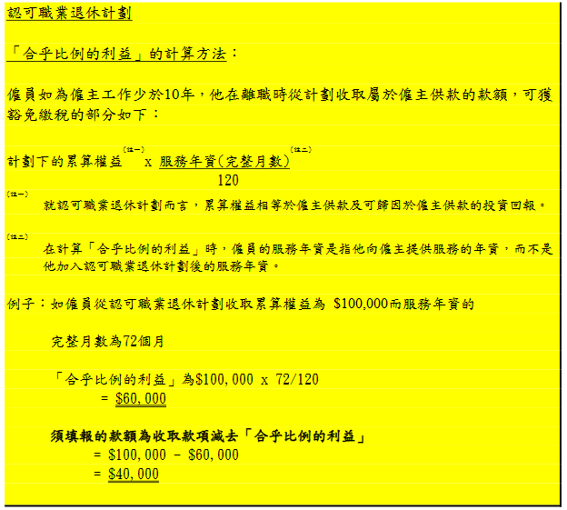
The Proportionate Benefit Rule
什么是合乎比例的利益?

Slide 24
THE SUMMARY OF BENEFITS OF THE PLAN
计划优势
Asset Protection 资产保护
Divorce-proof 避免离婚后的财产分割
Privacy 隐密性
Tax Efficiency 税务效率
Extremely Valuable Benefits – No Probate 无需遗嘱安排
Flexible Contribution 灵活供款
Investment choices 投资选择

Slide 25
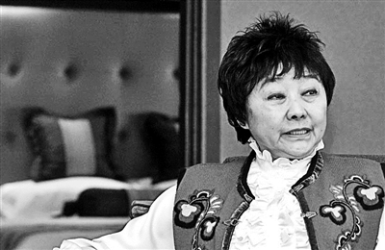
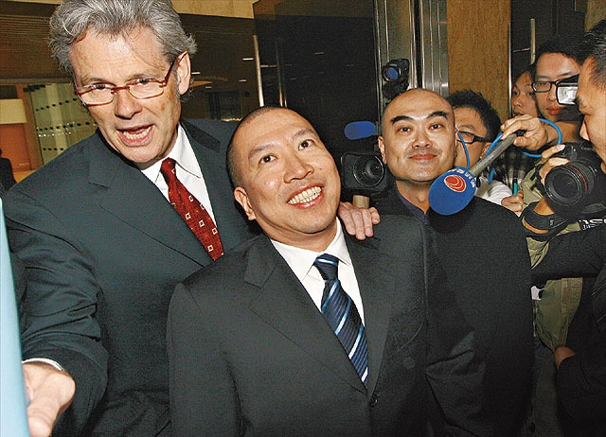
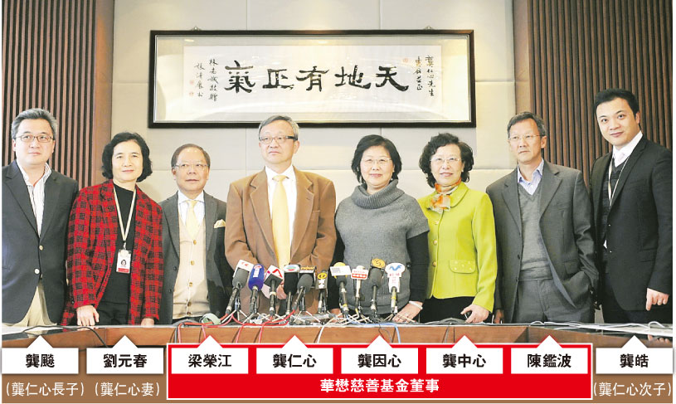
Extremely Valuable Benefits – No Probate
无需遗嘱安排

Slide 26
THE SUMMARY OF BENEFITS OF THE PLAN
计划优势
Asset Protection 资产保护
Divorce-proof 避免离婚后的财产分割
Privacy 隐密性
Tax Efficiency 税务效率
Extremely Valuable Benefits – No Probate 无需遗嘱安排
Flexible Contribution 灵活供款
Investment choices 投资选择

Slide 27

Flexible Contribution
灵活供款
随时供款，无上限
Contribute anytime and at any amount

Slide 28
THE SUMMARY OF BENEFITS OF THE PLAN
计划优势
Asset Protection 资产保护
Divorce-proof 避免离婚后的财产分割
Privacy 隐密性
Tax Efficiency 税务效率
Bloodline beneficiaries only 受益人只限血缘亲属
Extremely Valuable Benefits – No Probate 无需遗嘱安排
Flexible Contribution 灵活供款
Investment choices 投资选择

Slide 29
Investment power of trustee for ORS Registered Plan
计划受托人的投资
ASSET CLASS 资产类别 | REGISTERED 注册计划
EXCHANGE TRADED FUNDS 交易所基金 | ✔
LISTED SHARES 上市公司股票 | ✔
PRIVATE COMPANY SHARES 私人公司股票 | 🗶 (up to 10% of fund value)
CASH FOREIGN CURRENCIES 外汇 | ✔
BONDS 债券 | ✔
UNIT TRUSTS/MUTUAL FUNDS 单位信托 /互惠基金 | ✔
COMMERCIAL DEVELOPMENTS 商业开发 | Only REITS 只限上市公司
INSURANCE POLICIES 保險計劃 | ✔

Slide 30
HOW IT WORKS
计划运作
No Inheritance Tax | No Probate | Litigation Protection
No Capital Gains Tax | No Lifetime Limits | Government Regulated
Reduced Income Tax | No Forced Heirship
Contributable Assets
Your HK Retirement
Scheme Structure
Who’s Involved
Corporate Trustee
Name:
Henderson Fiduciary Limited
Mutual Funds
Hong Kong Retirement Scheme
Relevant Employer: ABC Company Ltd (incorporated in Hong Kong or Cayman etc.)
Cash
Stocks / Shares
Scheme Administrator
Name:
Henderson Fiduciary Limited
Bonds
Contribute into Scheme
International Custodian Account
Regulated Investment Manager
Insurance Policy
Pension Benefits at Age 55
Members
Pvt company shares (10% x total fund value)
Sponsor Hong Kong Limited Company
Corporate Secretarial Services
Name: Henderson Fiduciary Limited

Slide 31
Chinese Listed Company Example
中國上市公司例子
Employer and Member
Contributions
Cayman Islands Company
Listed Company
Sponsors ORS
ORS Trust
BVI Company
Funds Chinese
Company Premiums
Senior & Executive Staff
(Members)
Hong Kong Company
Loan Account
BORDER
Wholly Foreign Owned Enterprise (WFOE)
Chinese Company

Slide 32
Contacts

